Slide 1
Main Fuction Introduction
Linda8_Yang 2016/12/15

Slide 2
-(NSNumber*)SEND_COMMAND:(NSDictionary*)dicSendContents
This function for send command to target base on the Uart serial communication
“STRING” → Your send out command.
“TARGET” →Target for you send command to.{FIXTURE, MOBILE, LIGHTMETER…}

Slide 3
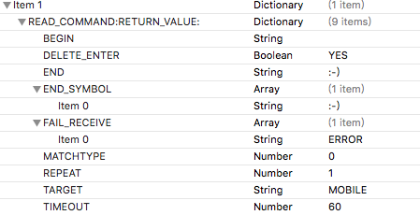
-(NSNumber*)READ_COMMAND:(NSDictionary*)dicReadSettings RETURN_VALUE:(NSMutableString*)szReturnValue

Slide 4
This function for read value from target base on the Uart serial communication
“BEGIN” → Cut value begin
“DELETE_ENTER” → Delete the enter for return value or not, if YES, will delete
“END” → Cut value end
“END_SYMBOL” → You stop receive message from target when met the symbol
“FAIL_RECEIVE” →Will show fail if meet value contains here

Slide 5
“MATCHTYPE”→0: Match all end symbols; 1: Match at least one of end symbols
“REPEAT”→Repeat times for receiving data, default is 1
“TARGET” → You receive return values from. {FIXTURE, MOBILE, LIGHTMETER…}
“TIMEOUT”→Wait time for receiving data from target, default is 5s

Slide 6
-(NSNumber*)MEMORY_VALUE_FOR_KEY:(NSDictionary*)dicMemoryContents RETURN_VALUE:(NSMutableString*)szReturnValue
This function for save value to dictionary with given key
“KEY” → Your key name

Slide 7

-(NSNumber*)CATCH_VALUE:(NSDictionary*)dicCatchSettings RETURN_VALUE:(NSMutableString*)szReturnValue
This function for catching value from value of memory key
“KEY” → Your memory key name
“REGEX”→The regular expression for catchmemory

Slide 8

-(NSNumber*)GET_MEMORY_VALUE_FROM_KEY:(NSDictionary*)dicMemoryContents RETURN_VALUE:(NSMutableString*)szReturnValue
This function for getting the memoried value by the given key
“KEY” → Your memory key name

Slide 9

- (NSNumber *)CHANGE_PRE_SUBITEM_RESULT:(NSDictionary *)dicPara RETURN_VALUE:(NSMutableString *)szReturnValue
This function for changing the previous sub item’s result
“RESULT”→The result will be PASS if you set the bool value to be YES

Slide 10

- (NSNumber *)CHANGE_RETURNVALUE_TO_PASS_FAIL:(NSDictionary*)dicPara RETURN_VALUE:(NSMutableString*)szReturnValue
This function for changing szReturnValue to PASS/FAIL, depends on last sub test item result
“SZ_FAIL”→If result failed,will return string set here
“SZ_PASS”→If result passed,will return string set here

Slide 11
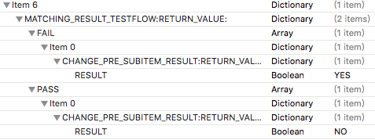
-(NSNumber*)MATCHING_RESULT_TESTFLOW:(NSDictionary*)dicPara RETURN_VALUE:(NSMutableString *)szReturnValue
This function for matching the previous result and deciding to do the FAIL flow or PASS flow

Slide 12
“MatchingString”→If result contains this matchingString, go to the PASS flow; else, go to the FAIL flow
“PASS”→If the previous result is PASS,do this;
“FAIL”→If the previous result is FAIL,do this;

Slide 13

-(NSNumber*)JUDGE_SPEC:(NSDictionary*)dicSpecSettings RETURN_VALUE:(NSMutableString*)szReturnValue
This function for judging the value is expected or not
“COMMON_SPEC”→”P_LimitBlack” and ”P_LimitWhite”, the default is black DUT
About the string format: If like [a,b], a<=value<=b; If like {string} or {NA},value in string or no spec here

Slide 14
If like (a,b), a<value<b; If like [a,b), a<=value<b; If like (a,b], a<value<=b; If like <a,b>, value=a or value=b
Mode:
Mode number | Spec format
0 | (a,b)
1 | [a,b]
2 | {stringa,stringb} or {NA}
3 | (a,b]
4 | [a,b)
5 | <string> or <NA>
0>mode or mode>5 | Invalid

Slide 15

-(NSNumber*)SET_PROCESS_STATUS:(NSDictionary*)dicSettingItems RETURN_VALUE:(NSMutableString *)szReturn
This function for setting process status such as priority, parimatric, unit, cancel to end and so on
“IP_Unit”→The unit of return value
“CancelToEnd”→If YES, will cancel to end when the item failed

Slide 16

-(NSNumber*)UPLOADATTRI:(NSDictionary*)dictUploadContents RETURN_VALUE:(NSMutableString *)szReturn
This function for uploading attribute to pudding
“ATTRIBUTE” → Your attribute keys need to uploading, can one key, two keys…

Slide 17
Thank You !

